Slide 1
Models of Workplace Engagement
Australia New South Wales
An alternative practice to work experience for 15-18 year olds.

Slide 2
Acknowledgement of Country
Image by artist 16 year old Sally Curnow created in a Career Learning Immersion week Dubbo New South Wales

Slide 3
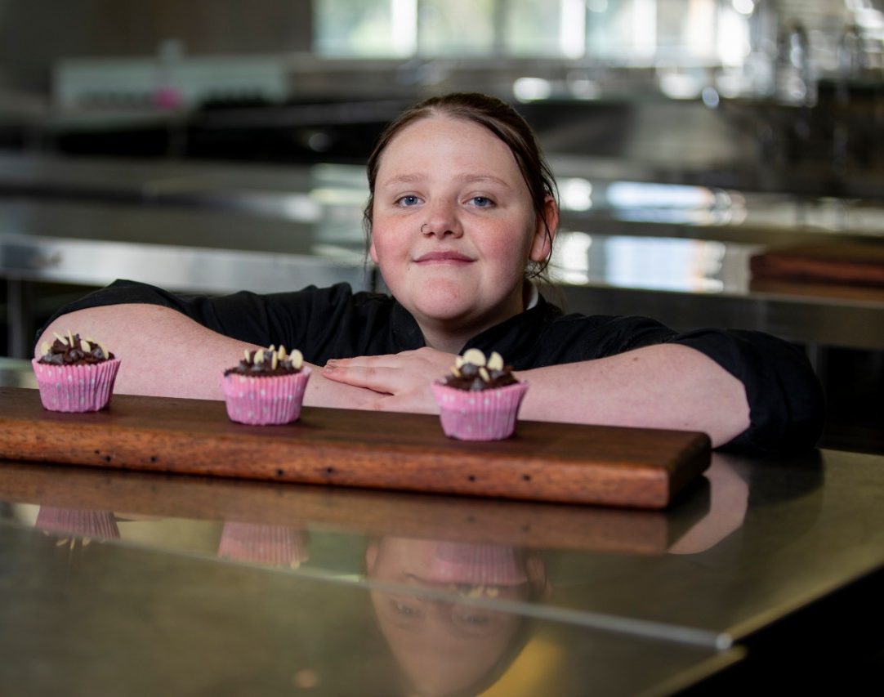
Schools generally send students 15–16-years of age to one week of work experience at the end of the school year.
Are there alternatives?
Notes:
Stage 1 – Research
1) Conduct research to create a snapshot of successful local, national and international workplace engagement models, along with related policy positions and reports.
2) Engage directly with targeted key stakeholders (including business and industry, tertiary providers, NSW Department of Education, community and government) through a state workplace engagement reference group to guide and inform forward directions for NSW schools.
3) Identify specific preferred or supported models, processes and approaches to explore in further details in stage 2.
Models identified through research

Slide 4
Researching student voice: what support needs did the students identify?
Help exploring career options and pathways
Practical help for work readiness
Guidance around the jobs market
Notes:
Our research aimed to understand what young people want to support them to better understand the world of work
Young people sought more career information, and from earlier in their schooling, ideally from year 9.
They wanted to know about different jobs, about workplaces, how to apply for work .

Slide 5
It’s kind of like something I’m looking forward to, but at the same time, it’s kind of daunting.
Student views on their future
Assessment of pilots
Actions following experiences
“
”
Notes:
Young people were optimistic about their future – both nervous and excited.
We wanted to understand how young people found the pilots
Students found the pilots better than expected - they said "it makes you feel like you are a someone, I’m excited to come to school and learn more stuff" "I’m better at communicating and talking to people, I have more confidence"
Nearly ¾ found the program good or very good, it exceeded their expectations
The pilots spurred student action – most talked to parents about potential careers, many changed their resumes. Over 60% became more focused on their studies.

Slide 6
What did the pilots involve?
OUTPUTS
TRAINING
EXPERTS
WORK
EXPERIENCE
Notes:
The pilots included key elements :
designing, developing and producing an output or outputs within school
training and skills development
job readiness, resume writing and interview skills
engagement with experts
integrate or relate work experience
The projects could be broadly grouped into four models

Slide 7
The Four Models of
Workplace Engagement
Notes:
From the pilot research and completion of activities four models of Workplace engagement emerged these included : slides 8-11

Slide 8
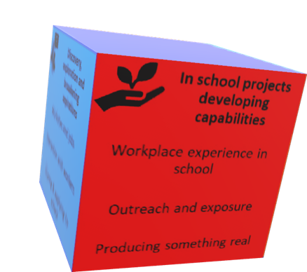
Model 1
In school projects that can occur for 5 year to 18 year olds.
Notes:
Any career learning project that involved activities in school e.g. primary school Discovery of jobs by have student come dressed as depicting a role model – position.
Embedding career learning in the curriculum .e.g. identifying communication skills through English and writing work relate documents.
A diverse group of students set up pop up clothing stores of antique clothing. Students learnt display technique/pricing and were supported by A Certificate III Retail class in the school

Slide 9
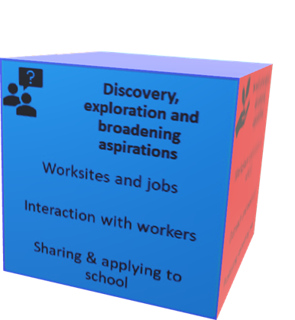
Model 2
Discovery, exploration and broadening aspirations.
Notes:
Creating opportunities to entice engage or reconnect with school
Work on or develop a passion or interest
Building self-esteem growth and direction
Development of entrepreneurial skills - business start up\

Slide 10
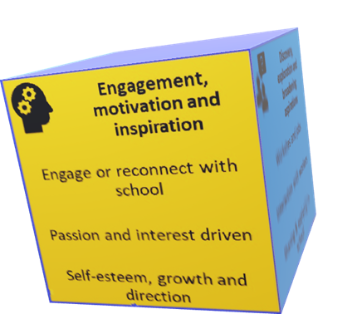
Model 3
Engagement, motivation and inspiration.
Notes:
Creating opportunities to entice engage or reconnect with school
Work on or develop a passion or interest
Building self-esteem growth and direction
Development of entrepreneurial skills - business start up\

Slide 11
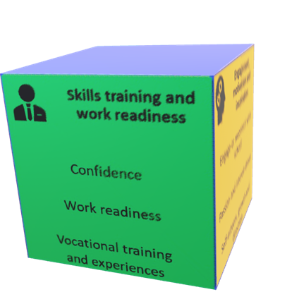
Model 4
Skills training and work readiness.
Notes:
Creating opportunities to entice engage or reconnect with school
Work on or develop a passion or interest
Building self-esteem growth and direction
Development of entrepreneurial skills - business start up\

Slide 12
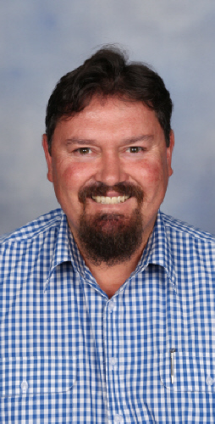
Glen Pearson
Orange High School - Model 4
Notes:
Glenda to introduce Glen

Slide 13
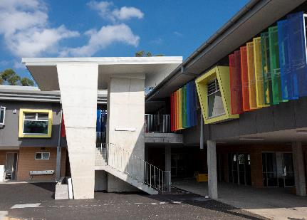
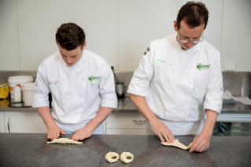
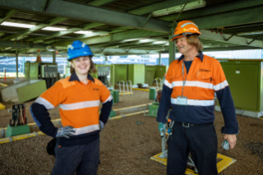
Model 4: Orange High School – Youth Engagement Strategy
Twelve Year 10 students targeted due to school disengagement.
TAFE NSW - One day per week for a term. A taste of nine different courses. The ultimate work experience!
Intensive day with Skillset resume(CV) writing, mock interviews and applying for jobs.
Student workplace immersion for one week. Industry area of interest.
Notes:
Slide #13
Model 4 – Skills Training & Work Readiness enables students to showcase and develop their: Confidence, Work Readiness, Vocational Training & Experience
My school is a great example of using a Model of Workplace Engagement.
Orange High School is a comprehensive secondary school located in the regional city of Orange NSW. We cater for approximately 1200 students from Years 7 to Year 12. We were involved in the Stage 1 Pilot in 2019. Our school project involved partnering with our local vocational education and training provider known as TAFE NSW, to give our disengaged Year 10 students the “ultimate Work Experience” opportunity. Selected students participated in practical activities showcasing nine different industries. Students had “a taste” of courses TAFE NSW offer in hairdressing, plumbing, welding, childcare, animal studies, nursing, beauty services, automotive and hospitality. We then had an intensive day with a local Recruitment company, Skillset, who have a great connection with local businesses to help these students with their Resume Writing, interview techniques and practice applying for a job. Once students identified an industry of interest, they then participated in a week of workplace immersion to gain some work experience.
Our project was successful as participants either gained full-time employment, an apprenticeship, continued school studies or commenced a school-based apprenticeship that combines completing Higher School Certificate studies with an apprenticeship. We were hoping to include a Year 9 Group (usually 15 year old students), as well as a Year 10 Group (usually 16 year old students) in 2020, but COVID-19 disrupted our plans. We look forward to be able to restart this project next year as it was such a success. Thank you

Slide 14
Positive student impacts
Growth in transferable soft skills
Learning business functions and process through simulation
Insight into workplace environments and culture
Attainment of career and job-specific skills
Tangible activities and qualifications to enhance job prospects
Developing self-esteem and sense of achievement
Positive engagement and reconnection with school
Notes:
From the first pilot a number of positive impacts emerged:
Growth in transferable soft skills- student began to reengage with peers and teachers and were able to articulate what they had done
Learning business functions and process through simulation- Through doing learnt,
Insight un workplace environments and culture – by being in the environment saw first had how a business or place of employment work – even one day visit allow the observation of a culture .
Students gained school based traineeships or full or part- time employment .
Students were involved in real work placement that lead to completion of a qualification.
Self esteem and self worth increased two fold and most importantly a reconnection back to the school and a desire to continue with education.

Slide 15
Developing and applying the models in 2021
Projects were broadly grouped into 4 models:
In school projects developing capabilities
Discovery, exploration, and broadening aspirations
Engagement, motivation and inspiration
Skills training and work readiness
Schools invited to test these models with resources and mentoring
Notes:
In 2020 funds were given to fourteen interested school to implement one of the Models and schools from the previous phase became mentors.

Slide 16
Value of being a mentor
The mentor role
was one of upskilling and being a sounding board for ideas.
Networking between New South Wales city and regional schools
Learning about transition programs and workplace engagement
Remote opportunities and COVID-19 innovations
“
”
Notes:
Glenda Mentoring is important to provide a link of experience and encouragement.
I was privileged to be part of the 2019 pilot group and a 2021 mentor. As a mentor I worked under Model 1 - 'In-house project developing capabilities'.
During 2021 I worked with regional schools; gaining knowledge on how schools implement in-house project such as pop-up shops, transition groups, employer presentations, school Cafes and environmental programs. As a mentor I listened to their ideas and shared any information that may assist. Often, we would just chat over the phone and bounce ideas about different projects, schools, employers, and students.
It was inspiring to hear about the different transition programs, how schools create citizens for their community thru workplace engagement programs, employment pathways that commence at the age of 14 and where students have a pattern of study suited towards their career goal. Communities where employer links are high valued and student experience 'real' jobs.
One of the Covid innovations was the opportunity to hear from seven different schools over 'Microsoft Teams'; to learn about their innovative and evolving projects. Also, to hear how the schools will move forward.
Being a mentor has provided me new ideas for my own school, has motivated me to create future inspiring projects and to remember that every student has their own pathway.

Slide 17
Matt Dolan
Futures Advisor – Lindfield Learning Village
Notes:
Glenda introduce Matt

Slide 18
Uncovering the How - The Quadrant
Matt Dolan – Lindfield Learning Village
School Integration
Community
Every student is telling their own story – We are just characters
Student Voice
Providing students with greater ownership over their own journey by upskilling them
Self-Management
Entrepreneur
Notes:
Exactly what Matt is saying:
"Every student that we come in contact with are in the process of writing their own story and we, as educators, are lucky enough to be characters in this story.
It is important to acknowledge that while we bring out own set of skills, knowledge and experience to the table, we are ultimate there to help our young people on their journey, and it is their voice that we need to hear that will guide the direction that we take them through The Quadrant.
Regardless of our school contexts, we aim to engage, inspire, upskill and increase the aspirations of the young people in our care and depending on the students needs, wants and desires, we decide which of the four quadrants would best meet these.
Each quadrant provides them with an element of growth in their own personal employability skills that they would have received from the traditional week of work placement without sending them out.”

Slide 19
Apply The Quadrant – Case Study
Matt Dolan – Lindfield Learning Village
School Integration
Activities that specifically tied into KLA content
Community
All industry experts were local to the school and had a connection
Stage 5 Virtual Work Experience
Purpose: Increase Exposure
Term 3, 2021
During Sydney Lockdown
24 Industry Experts, 6x 2hr Learning Experiences
97% felt more knowledgeable about the world of work
Student Voice
Self-Management
Key driving question was how do enterprise skills cross industries
Entrepreneur
Students needed to make something real and visible each week
Notes:
What Matt is Saying:
"In 2021, when my original plan for Work Readiness was pulled swiftly from under my feet as we transitioned to learning from home, I collaborated with key stakeholders to create a Virtual Work Experience that was specific to the students at my school.
The first thing that I needed to do was to capture their voice – having increased uncertainty during COVID meant that this was the critical step. From this data, it was determined that the collective need of the cohort was to increase exposure to the world of work – this is what guided the way that I designed the program.
When setting up the program, I stopped and asked myself the following questions (based on the quadrant):
How can I increase exposure to my community? I can interview local community members
How can I upskill and educate the students in their self-management skills? I can have them reflect on the key skills they are using, that they can put on their resume
How can I integrate this into the school? I can work with subject teachers to bring lessons and content into the learning experiences?
How can I build their entrepreneurial skills? The students needed to create something real and visible, that could be shared with others.
Once these questions had been answered, I undertook the process of designing 24 different learning activities that transcended across different industries, including local, national and international. Students would then opt-in to 6 industries across the term.
The program was incredibly successful, with 97% of students reporting that they felt more knowledgeable about the world of work. The students could see how their voices had been captured to build the program, so they were able to take ownership over their own learning, to help upskill them as they continue to write their own story.".

Slide 20
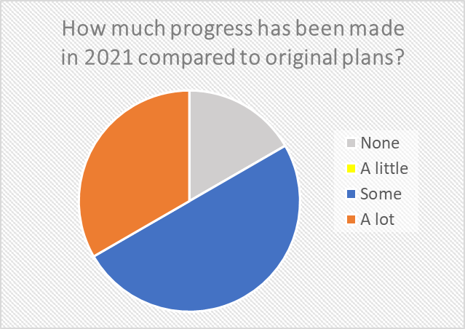
Cannot run project unless students are on site.
COVID-19 impact and innovation
“
Some schools were
stopped in their tracks:
For others access to
models reduced
planning time and
meant they
were quick to start:
”
Work experience was possible in the first term - so that was good and reinforced that we were on the right track - in both developing micro credentials for the students and the industry exposure.
“
”
Notes:
We found that some schools were quick to start – the models afforded them a head start.
COVID innovations included remote learning helping students to study out of hours
An important innovation was supporting parents to take part in career conversations using technology. Careers coordinators found it easier to engage more families through remote means

Slide 21
How do young people think about their future in 2021?
Notes:
Our young people were ambitious and excited about their future – most saw covid as a sort term disruption
Careers are important to them, and they remained confident they would gain a job they would like

Slide 22
Student feedback from outcomes 2019 to 2021
I am better at communicating, better at talking to people, more confidence
Results exceeded 2019 – by average of 15%
Over 70% students increased :
understanding about different work and career options
skills and resources
Nearly 70% students more prepared, motivated and confident
“
”
Notes:
Feedback from students in 2021 shows that the projects are even more successful. We revisited the questions posed to the 2019 cohort, and found even greater impacts.
Most students learned about different career options, and felt more prepared and confident.

Slide 23
Student action – 2021
Nine out of 10 students completed follow up actions – talked to parents, amended resumes, talked to career advisor
One in five students surveyed got a job, including an apprenticeship or traineeship
One in three students refocused on their studies and were more motivated
Notes:
Despite COVID young people took action, talking with parents, reshaping resumes, and even getting jobs.

Slide 24
Key Learnings and going forward
Support needed to share ideas and innovations
Resources will further help schools to implement the models
Ongoing profiling of good practice case studies and successes to support broader adoption
Learn from COVID-19 adaptations including different ways to engage students and families
Flexible funding provided careers coordinators with authority to trial
Notes:
Moving forward the Department will present the models as best practice.

Slide 25
Credits: principals, teachers and students of the following schools and to industry leaders who formed the reference group. For further information please contact: glenda.obrien@det.nsw.edu.au
Anson Street School - Orange
Blayney High School
Camden Haven High School
Crestwood High School
Cumberland High School
Dapto High School
Elizabeth Macarthur High School
Hawkesbury High School
Henry Kendall High School - Special Education Centre
Hunter River High School
Lindfield Learning Village
Murrumbidgee Regional High School
Nepean Creative and Performing Arts High School
Northern Border Senior Access Program
Orange High School
Ryde Secondary College
Swansea High School
Seven Hills West Public School
Sydney Secondary College Blackwattle Bay
The Rivers Secondary Campuses - Richmond River High Campus
Ulladulla High School
Wadalba Community School
Wollongong High School of the Performing Arts
Yass High School
Notes:
Thank you questions ? 10 minutes have been allowed

